Slide 1

E-Commerce Shipping data Analysis
Ng Soo Kuan

Slide 2
Agenda
Business Understanding
Data Understanding
Data Analytics Solution Architectural
Exploratory Data Analysis (EDA)
Summary of Findings
Limitations & Recommendation

Slide 3
Business Understanding
A E-commerce company selling electronic products discovered recently there is surge of customer’s complaints related to shipping and delivery.
Late shipment delivery net promoter score will drop sharply which potential impact customer lifetime value.
Bad delivery experience may impact customers’ satisfactions which can cause high churn rate.
Company revenue may drop due to drop of customers’ satisfactions.

Slide 4
Data understanding
One of the crucial dataset that potential help to solve the business problems is shipping data. The metadata of the shipping data as below:
ID: ID Number of Customers
Warehouse_block: The Company have big Warehouse which is divided in to block such as A,B,C,D,E.
Mode_of_Shipment: The Company Ships the products in multiple way such as Ship, Flight and Road.
Customer_care_calls: The number of calls made from enquiry for enquiry of the shipment.
Customer_rating: The company has rated from every customer. 1 is the lowest (Worst), 5 is the highest (Best)
Cost_of_the_Product: Cost of the Product in US Dollars.
Prior_purchases: The Number of Prior Purchase.
Product_importance: The company has categorized the product in the various parameter such as low, medium, high.
Gender: Male and Female.
Discount_offered: Discount (%) offered on that specific product.
Weight_in_gms: Weight of the parcel in gms
Reached.on.Time_Y.N: 0: no delay, 1: delay

Slide 5
Data Analytics Solution Architectural
Data sources: Shipment data, Distribution data, Customer behaviors data …etc
Data Storage/Data Lake
Data Warehouse/Data Marts
Data Processing and Transformation
Exploratory Data Analysis
Modelling

Slide 6
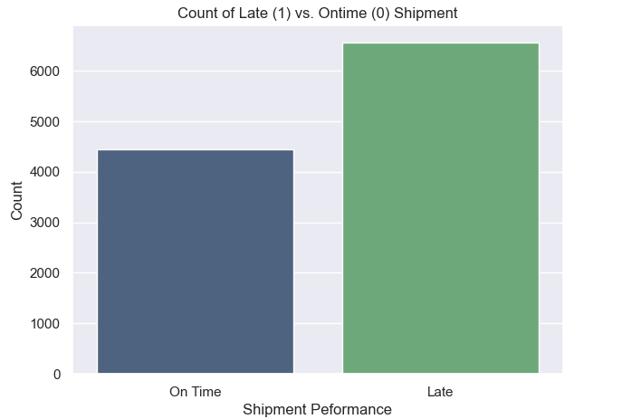
Exploratory data analysis
Validate the amount of On Time and Late shipment.
Based on the findings, amount of Late shipment is higher than On Time shipment.

Slide 7
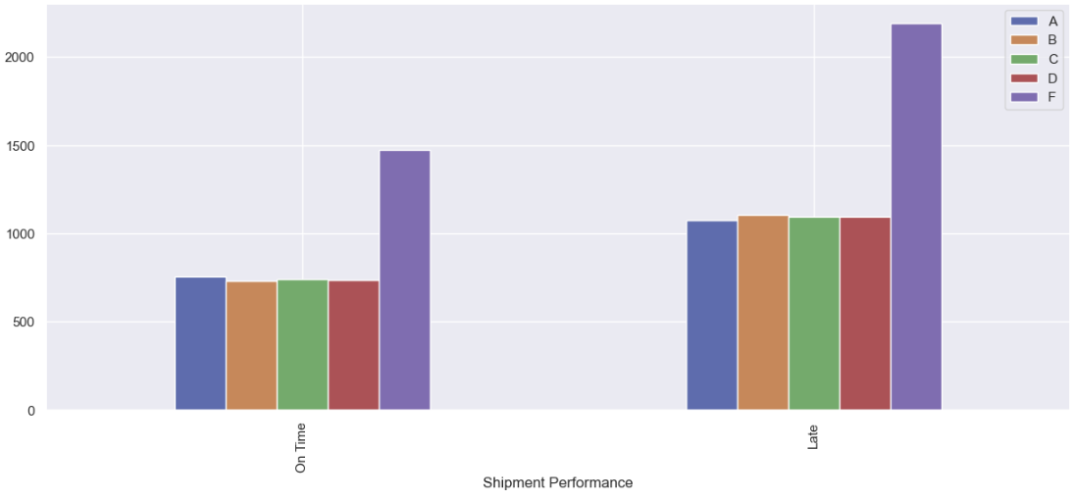
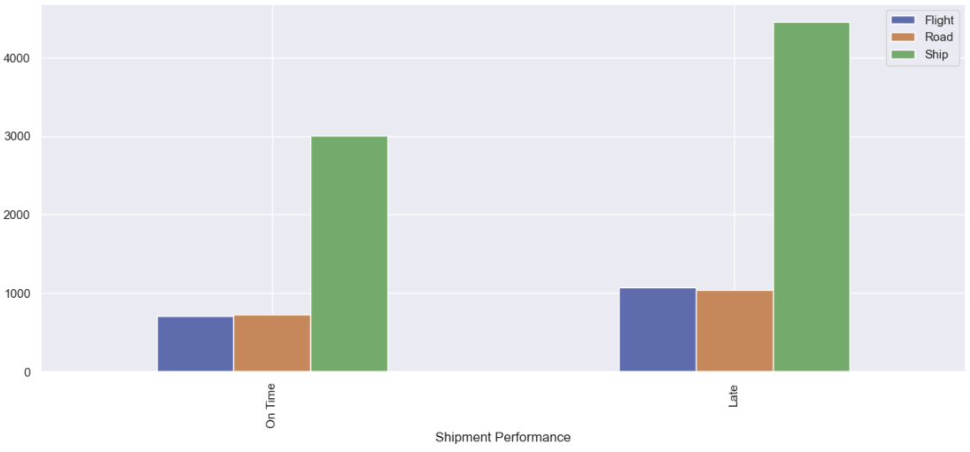
Exploratory data analysis
Validate relationship between warehouse block with shipment performance.
Based on the findings, amount of shipment mostly from warehouse block F and is the highest for late shipment too.
Validate relationship between shipment mode with shipment performance.
Based on the findings, Sea ship contribute to highest amount of product shipment and is the highest for late shipment too.

Slide 8
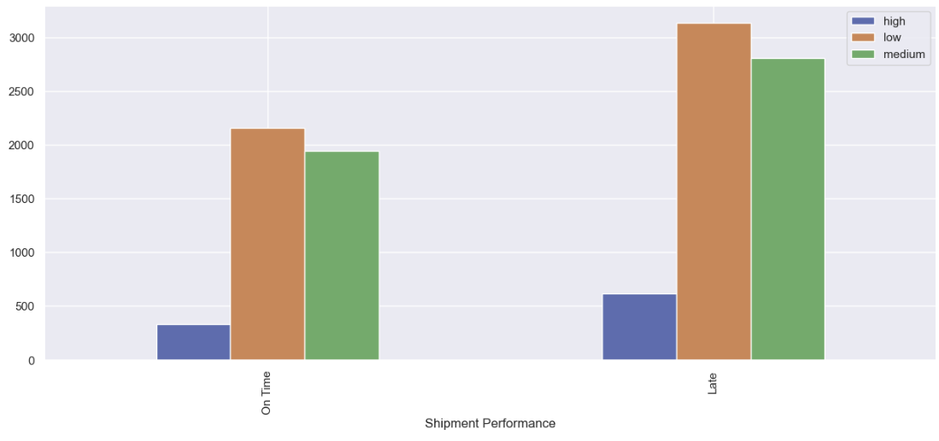
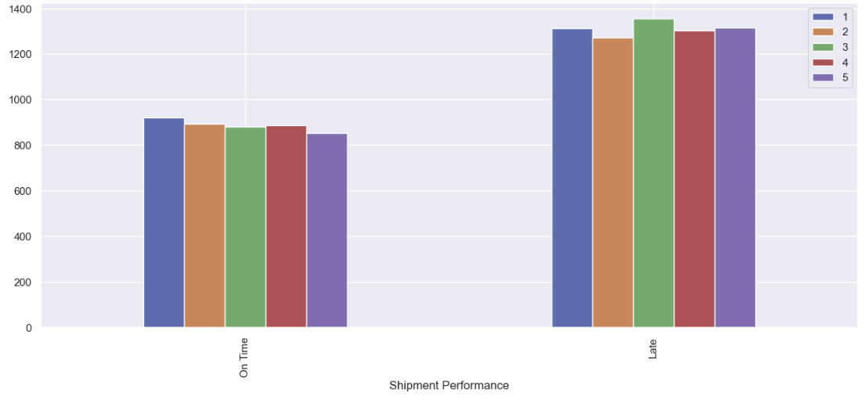
Exploratory data analysis
Validate relationship between product importance with shipment performance.
Based on the findings, amount of shipment mostly from low & medium importance and contribute to highest late shipment too.
Validate relationship between customer rating with shipment performance.
Based on the findings, there is no significant relationship between customer rating (1-5) to late shipment.

Slide 9
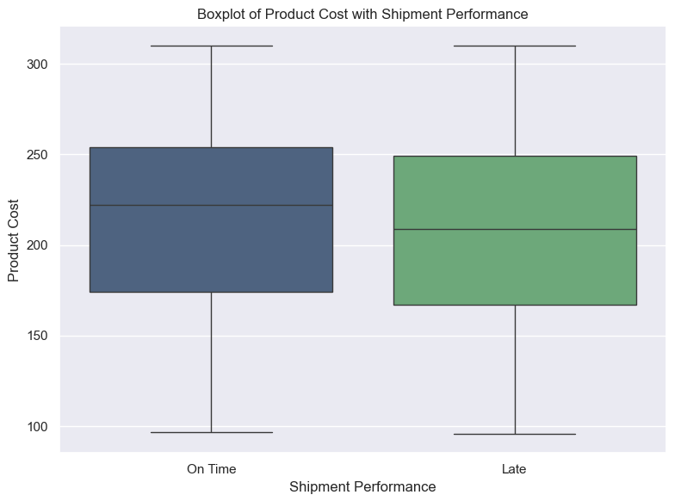
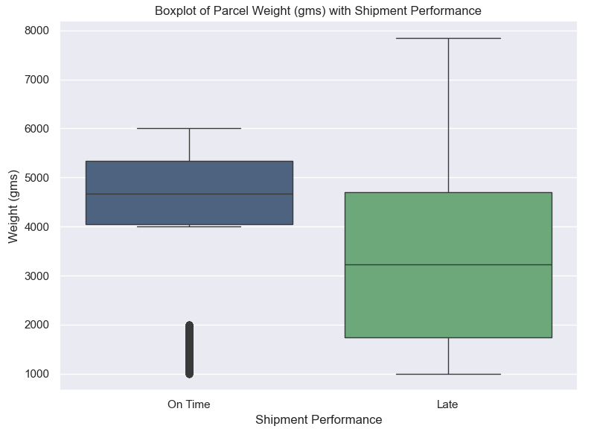
Exploratory data analysis
Validate relationship between product cost with shipment performance.
Based on the findings, no significant differences between the product cost distribution between On Time and Late shipment.
Validate relationship between parcel weight (gms) with shipment performance.
Based on the findings, there are outliers of weight for On Time shipment. The weight distribution between On Time and Late shipment is different. Higher the weight may contribute to late shipment.

Slide 10
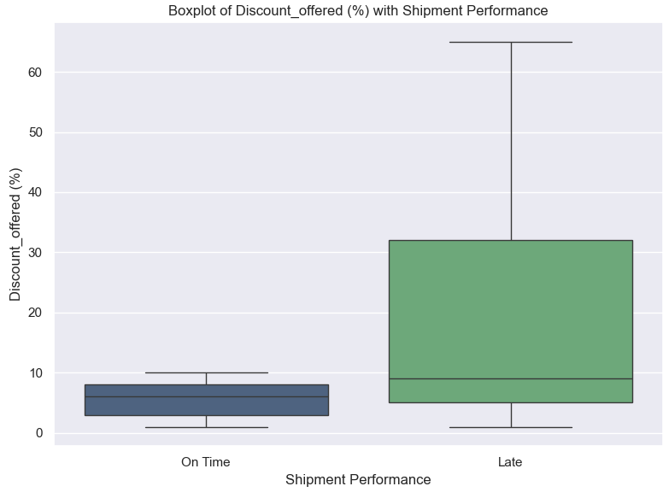
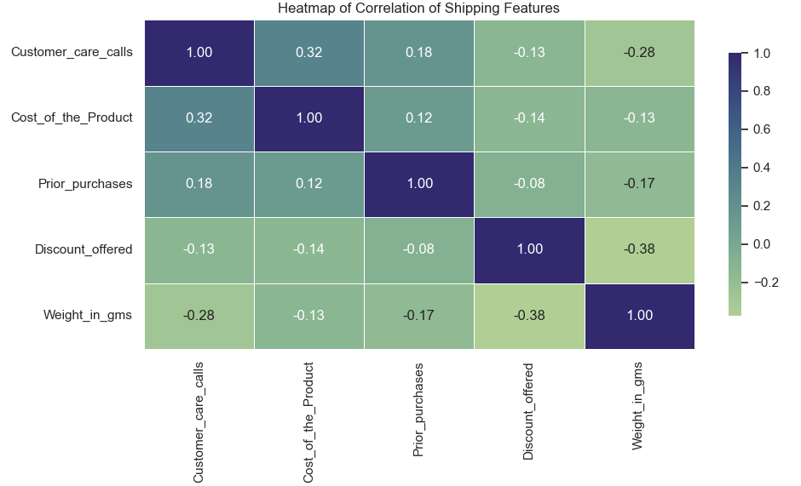
Exploratory data analysis
Validate relationship between Discount offered (%) with shipment performance.
Based on the findings, higher discount products may contributed to late shipment.
Validate correlation for numerical variables
Based on the findings, correlation between numerical variables are not high.

Slide 11

Exploratory data analysis
Hypothesis Testing on new (low Prior_Purchase) and repeated (high Prior_Purchase) customer with shipment performance.
Using Test Statistic (T-test). The hypothesis as below:
The results with alpha = 0.05:
There is no difference in shipping performance for new and repeated customers.

Slide 12
Summary of findings
Summary of analysis & suggestions :
Higher discounted products may contribute to late shipment. Need to prepare resources and monitor closely during the sales campaign.
Higher the weight may contribute to late shipment. May need to engage 3PL that good in handling high weight products.
Low and medium importance product may contributed to late shipment. Need to manage customer delivery expectations for the target ETD/ETA to reduce customer’s complaints.
Need to take attention on operation for sea ship and warehouse F.
There is no difference in shipping performance for new and repeated customers. Repeated customers maybe consist of loyal customers. Need to ensure customer satisfaction on loyal customers are well taken care of.

Slide 13
limitations And Recommendations
Limitations | Recommendations
Late shipment may impact the customer satisfactions. Currently need addition KPI metrics to measure the performances. | Need measure NPS (Net Promoter Score) on Delivery/Logistic. After implement the solutions, can measured the outcome by using NPS.
Current shipping data provides important insights about shipment performance that already happened. There is no preventive action to mitigate the late shipment. | Create ML or statistical model to predict the shipment performance. Prescribe some actions to mitigate the risk of late shipment which potential impact customer satisfaction.
Current dataset may not enough to diagnose the root cause of late shipment completely. | Need to look into additional dataset (product types/category, 3PL performance, shipping destination…etc) to further analysis.
There is no date about snapshot of data. Unable to determine when the data is pull. The date of data pulling is very important to determine when the analysis should conduct based on requirements | Include date about snapshot of dataset so data analyst/data scientist will know which time range of the data need to pull based on requirements.

Slide 14
Reference
https://www.kaggle.com/code/paulbacher/e-commerce-shipping-data-eda/input

